Slide 1
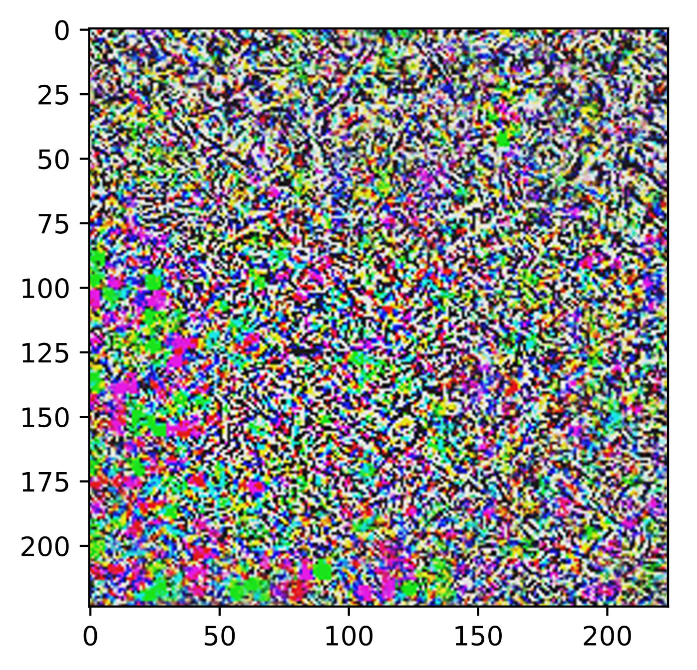


Robustness Of Deep Neural Networks With Trainable Activation Functions
FACOLTÀ DI INGEGNERIA DELL’INFORMAZIONE, INFORMATICA E STATISTICA
Master Degree in Computer Science
Thesis Defense
Candidate:
Federico Peconi
Thesis Advisor:
Prof. Simone Scardapane
Academic Year:
2019/2020

Slide 2
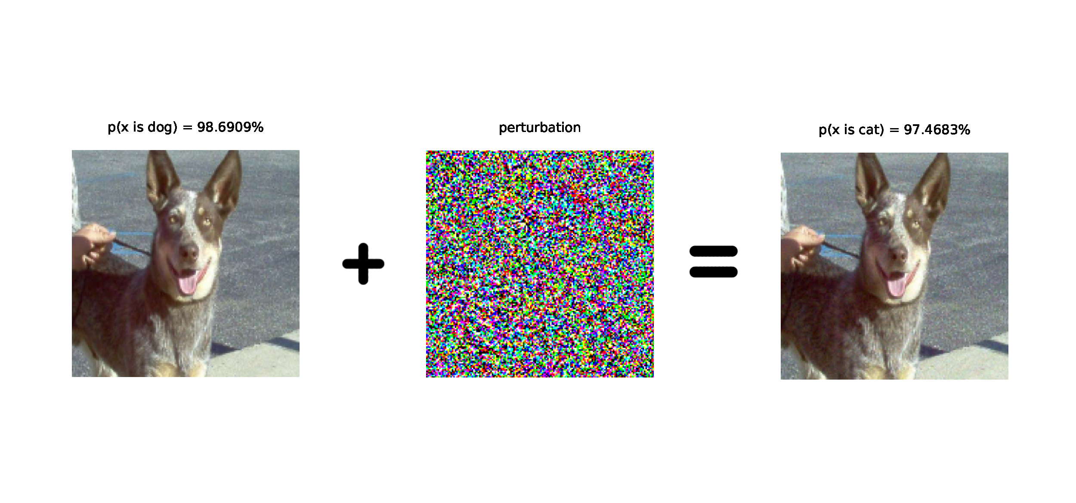
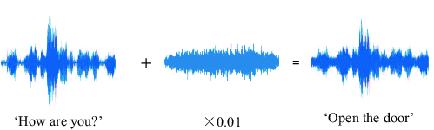
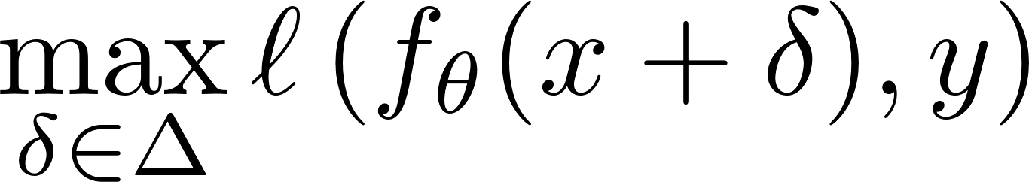
Intriguing Properties Of Neural Networks
Neural Networks are brittle w.r.t. non-random, small perturbations of the input [Christian Szegedy, Wojciech Zaremba et al. 2014]
Adversarial Examples can be found in several different domains other than image classification:
Natural Language Processing [Moustafa Alzantot et al. 2018]
Automatic Speech Recognition [Yao Qin et al. 2019]
and so on …
Can be computed through backpropagation and gradient ascent, optimizing:
[Yuan Gong, Christian P. 2018]
Notes:
the brittleness problem was actually known since the early 2000’s, however, with Szegedy et al. we have the first characterization on how to find such worse case adversarial examples
perturbation is basically imperceptible to the human-eye or at least ‘apparently’ not semantically significant. A human would of course still classify the perturbed image as a dog, whereas a performant classifier is convinced the image is depicting a cat.
3) Where the perturbation delta need to stay within the set of allowed perturbation i.e. small perturbation, l is the loss function, f_theta the classifier and x,y respectively the sample and its true class
The thesis focuses on this problem in particular we developed an attempt to try to make these models more robust against adversarial examples

Slide 3
Agenda
Motivations and Current Effective(?) Defenses
Kernel-Based Activation Functions (KAFs)
The role of activation functions in Adversarial Training
VGG architectures-inspired results
ResNet20 results
Contributions and Future Works

Slide 4
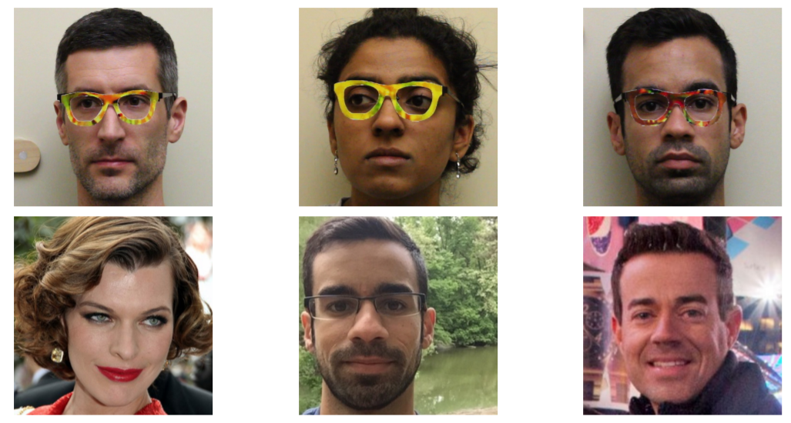
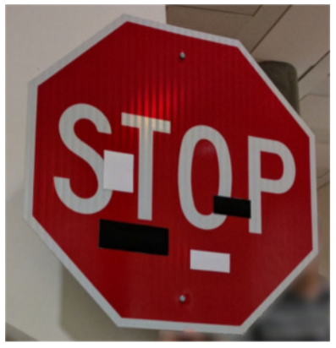
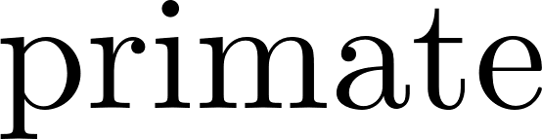
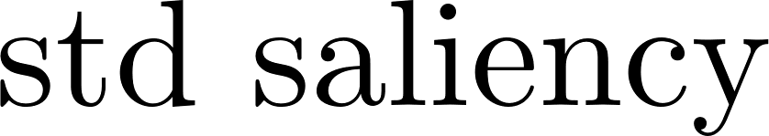
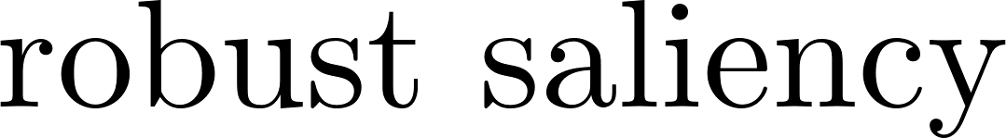
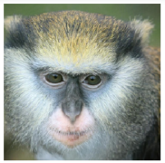
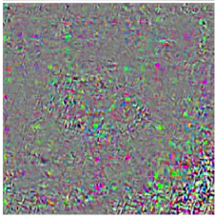
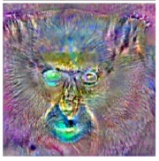
Motivations
High Security Concerns:
Safety-critical applications not yet reliable
Malware, intrusion detection
Face recognition
…
[Kevin Eykholt et al. 2018]
[Mahmood Sharif, Sruti Bhagavatula et al. 2016][
We want to develop human-aligned models:
Basic idea: humans do not suffer from such brittleness
Robustness and Interpretability seem to be strictly connected
“Adversarial examples are not bugs, they are features” [Madry et al. 2019]
[Dimitris Tsipras, Shibani Santurkar et al. 2019]

Slide 5
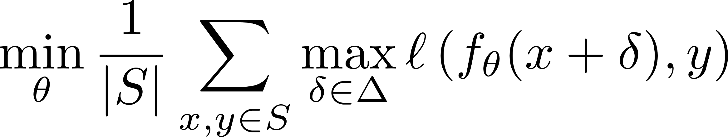
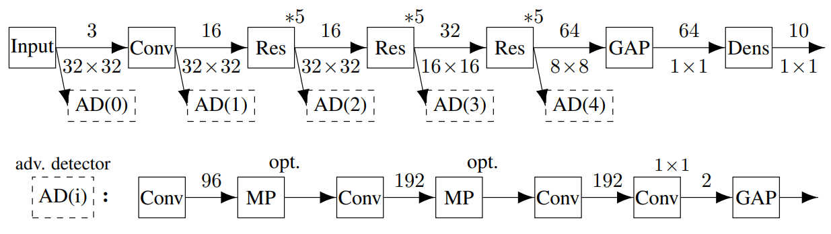
Defenses
Detection Methods
Provable Robustness
Add a “patch” to the network which is in turn another neural network.
Such NN, is used as a detector to spot adversarial perturbations from the analysis of layer’s statistics.
Training samples extended with a binary label denoting the presence of an adversary
Easy to perform, tractable computational overhead
Tend to overfit on the specific attack used during training
Adversarial Training (AT)
Aims to give a formal certification of the robustness of a model.
We want to guarantee that, for any allowed perturbation our model will always predict the correct class
Problem approached through different techniques:
Lipschitz Regularization
Linear Programming
Semi-Definite Programming
Randomized Smoothing
Train to approximate the min, max:
Inner maximization is computed crafting adversarial examples on-the-fly
Running-time boosted with novel techniques: [E. Wong, L. Rice 2020]
Only unbroken known defense, believed to be truly robust
Robustness accuracy up to 50%
Std Accuracy ~ 80 %
(CIFAR10, delta <= 8/255)
Provides provably robust models (up to computationally negl. probability)
Currently intractable for large-scale networks, architecture-specific implementations
[H. Metzen et al. 2017]

Slide 6
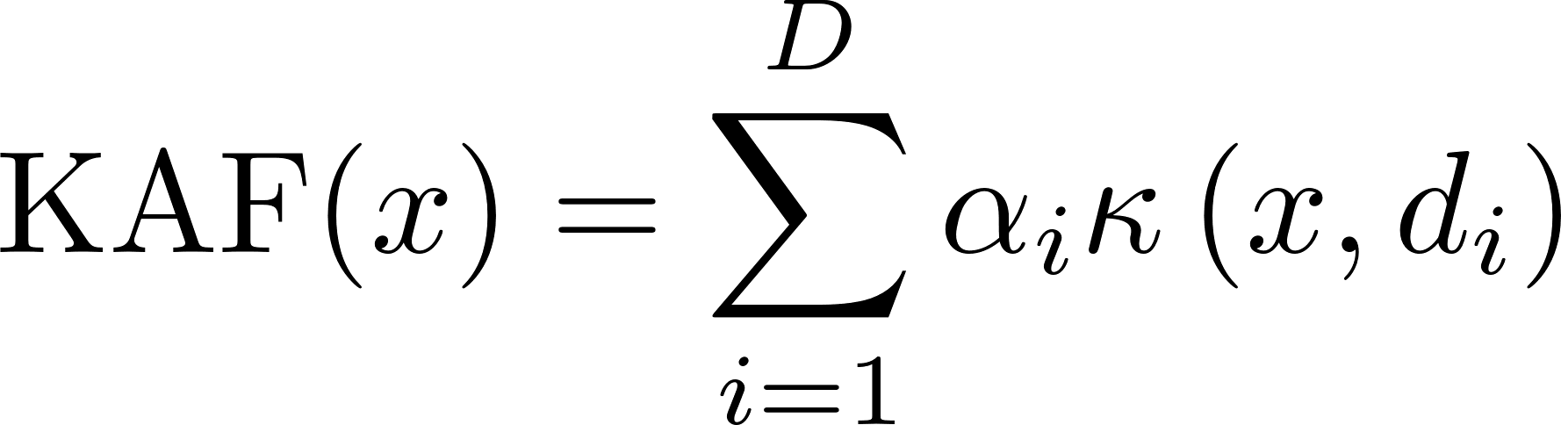
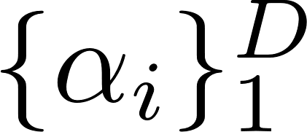
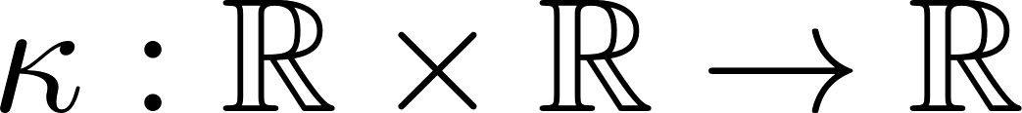
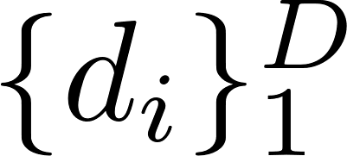

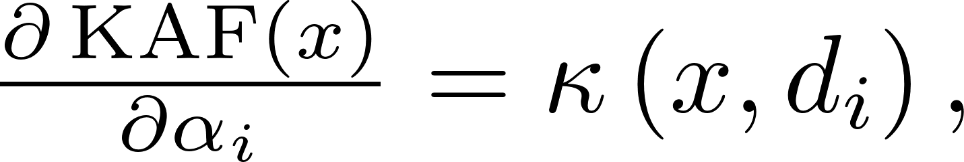
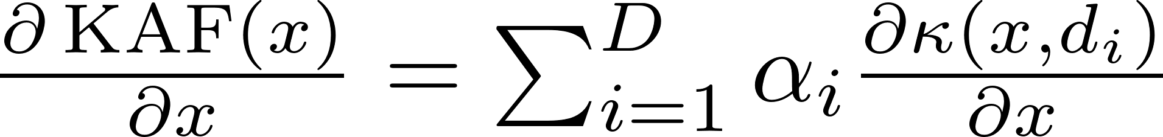
Kernel-Based Activation Functions
Along with ‘traditional’ fixed activation functions (e.g. ReLU, ELU, Tanh, Swish, ..), we can devise adaptive activation functions whose shape is learned through the optimization of parameters present in their formulation:
Adaptive Piece-Wise Linear Activation Functions (APLs) [F. Agostinelli 2014]
Spline Activation Functions (SAFs) [S. Scardapane, M. Scarpiniti 2017]
Maxout layers [I. Goodfellow et al. 2013]
In [S. Scardapane, S. V. Vaerenbergh 2017], authors introduce a novel class of trainable activation functions called kernel-based activation functions (KAFs):
Where are the weights to train, called mixing coefficients.
is a 1-dimensional kernel method.
are the kernel’s dictionary elements and the dictionary size, which is user-defined.
First derivatives:

Slide 7
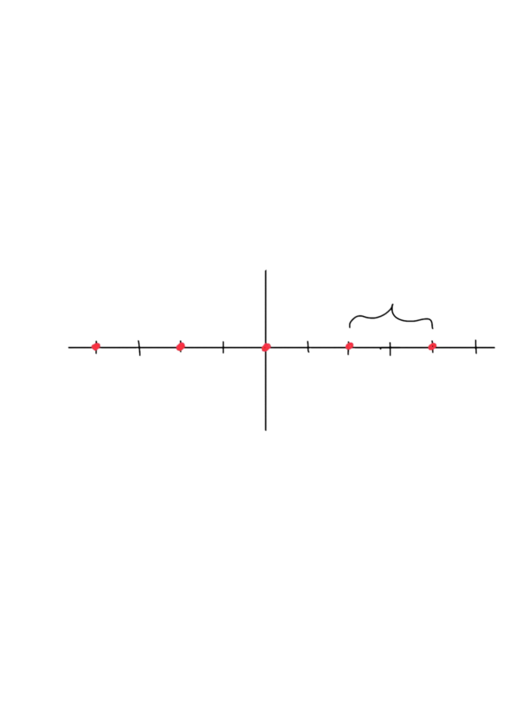

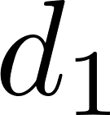
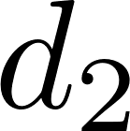
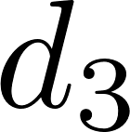
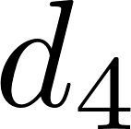
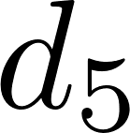
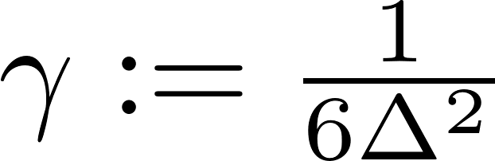
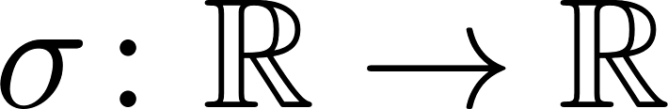
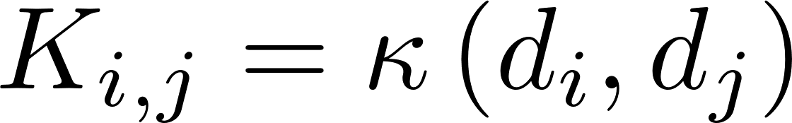

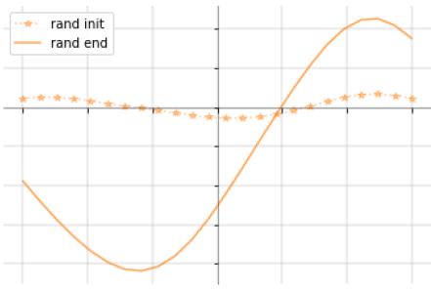
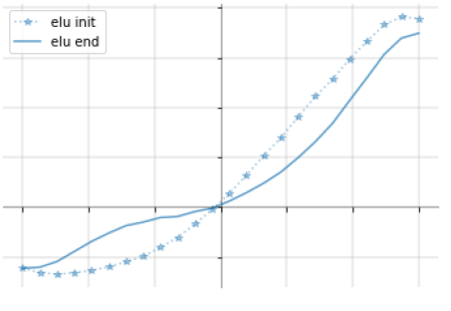
KAF Design Details
Dictionary elements uniformly sampled around 0 with step size
Gaussian kernel:
Heuristic
Guarantees a local effect of the mixing coefficients w.r.t. the overall shape ease optimization
Mixing coefficients are initialized either:
Randomly from a normal distribution
With ridge-regression if we want to approximate any fixed activation function
with:
Such constructed KAFs satisfy:
Universal approximability
Smoothness over the entire domain
Only linear number of weights introduced in the model
Mixing coefficients admit common regularization techniques

Slide 8
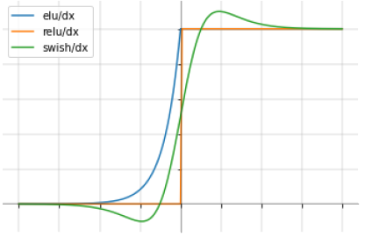
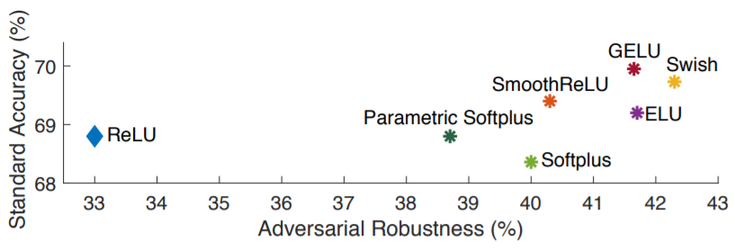
Smooth Activation Functions and AT
Can activation functions play a role in making neural networks more robust?
Remark: to perform adversarial training we compute twice the number of gradient computations used for standard training, that is, both for the inner maximization and the outer minimization.
In [Chiang Xie, M. Tan, B. Gong et al, 2020] authors conjectured that the widely-used ReLUs activation functions weaken AT due to their non-smooth nature
Empirical results: by enforcing smoothness, replacing ReLUs with smooth counterparts, it is possible to train the network against stronger adversarial examples, which eventually leads to a significant improvement in the robustness

Slide 9
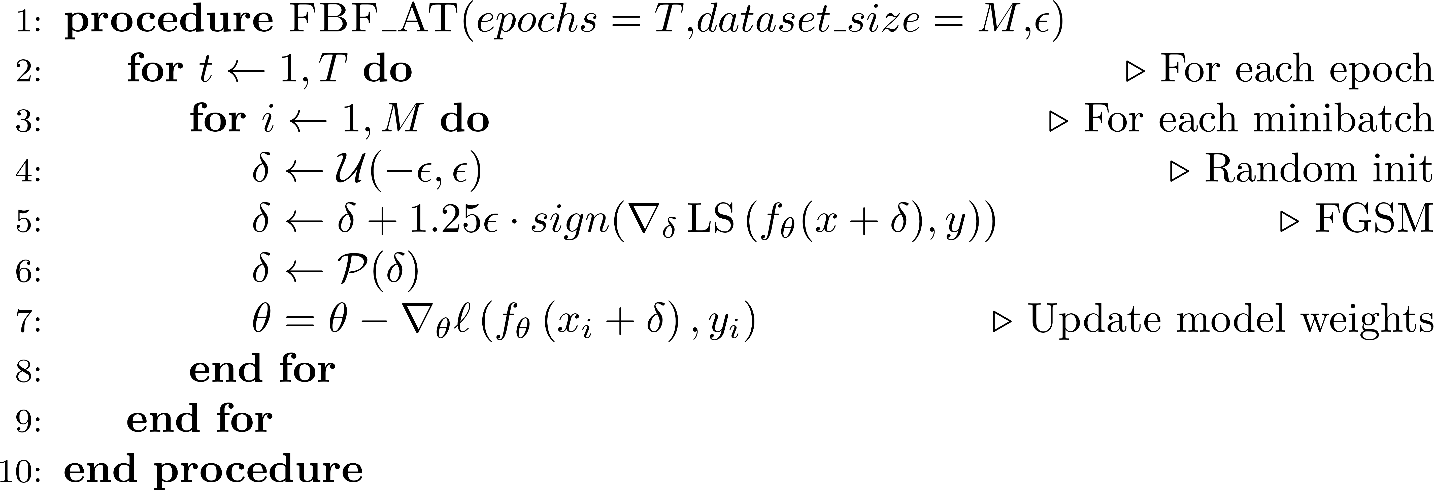
Hypothesis
Smoothness
Flexibility of KAFs
KAFs might be able to enhance even more the robustness and the accuracy of adversarially-trained models.
By leveraging flexibility, KAFs proved to outperform fixed activation functions in a variety of (adv. free) tasks
Using the Gaussian kernel we can enforce smoothness
Formally this translates to: potential to improve both outer and inner optimization, respectively

Slide 10
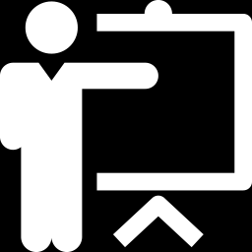



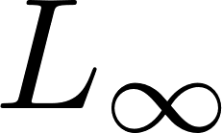
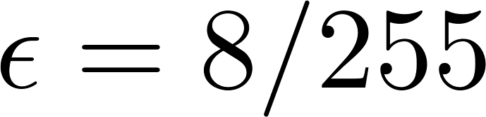
Experiments Set-up
ADVERSARIAL
TRAINING
ADVERSARIAL ATTACK
EVALUATION
CYCLICAL
LEARNING
RATE
For each activation function:
Training:
Fast Adversarial Training [E. Wong, L. Rice 2020] until convergence
One-Cycle learning rate policy [Leslie N. Smith 2018] and mixed-integer precision
CIFAR10 image classification dataset
SGD optimizer and batch size of 128
Categorical cross-entropy loss
Dictionary size for KAFs is D = 20
Adversarial examples computed through Projected-Gradient Descent (PGD)
Any perturbation lies in the norm-ball bounded by
50 iterations sufficient for convergence
10 random restarts
Evaluation
Robustness i.e. accuracy of the model over PGD-perturbed test set
Accuracy i.e. standard accuracy over clean test set

Slide 11
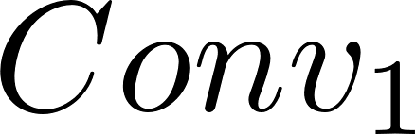

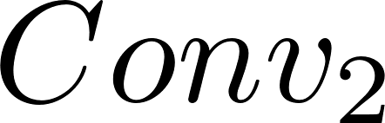
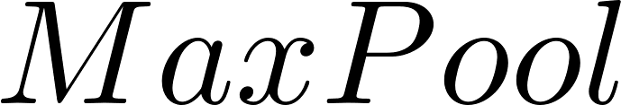
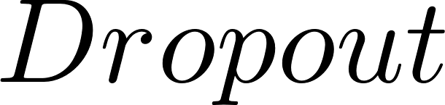
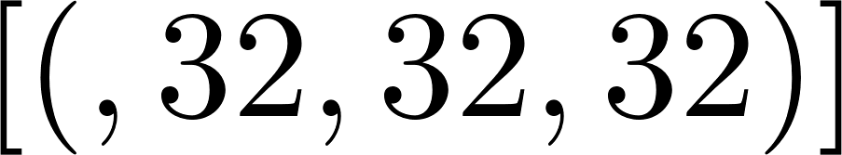
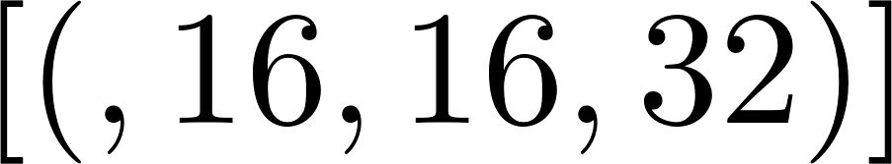
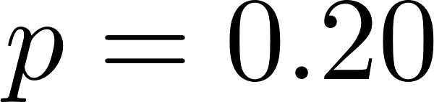
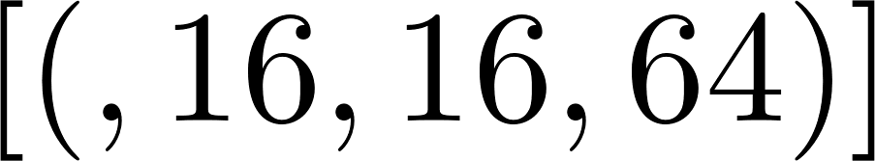
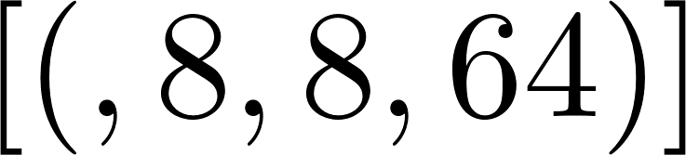
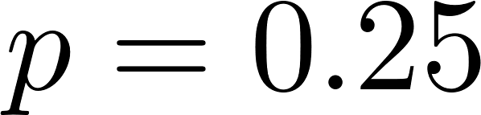
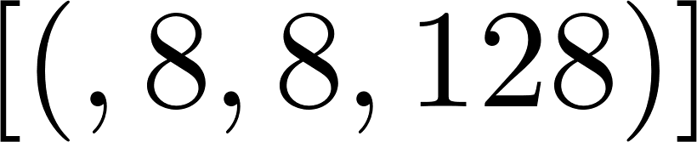
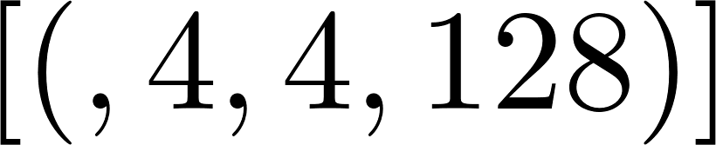
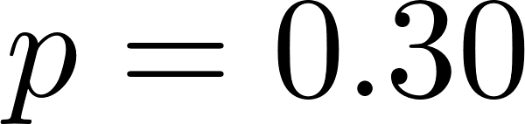



VGG Results
VGG-inspired architecture: three consecutive convolutional blocks
Followed by: flatten layer, fully-connected layer w/ 128 units, dropout and a decision layer with softmax.
Train and evaluate seven different architectures that differ only on the activation function employed:
Tab1: Bold denotes best result, underline best trade-off

Slide 12


ResNet20 Results
Max-pooling layers are non-smooth, which makes our hypothesis misplaced in the first place. We need to enforce smoothness throughout the whole model to perform a meaningful evaluation.
Due to its relatively simple implementation and strong performances we decided to repeat the experiment using a residual neural network (ResNet).
We experienced an exploding gradient issue using KAFs in deep (>50 layers) scenarios, thus we chose a ResNet20 architecture as described in the original paper [Kaiming He, X. Zhang et al. 2015]
Data augmentation: 4 pixels are 0-padded on each side of the image and a 32 × 32 crop is randomly sampled from the resulting image or its horizontal flip.
Overall robustness improved wrt VGG case ResNet better suited for adversarial training (approx. same number of weights)
KAFs reach best std accuracies, nevertheless, Swish function allows again for strongest robustness

Slide 13
Conclusions and Contributions
Sub-optimality in terms of robustness might be explained with the introduction of new parameters which comes with KAFs and ultimately with an increased non-linearity of the model’s landscape. Despite being leveraged by AT, it can also be exploited by any gradient-based attack.
Fix: Try to use Madry’s original adversarial training procedure instead [A. Madry, A. Makelov, L. Schmidt et al. 2017]
Presented results can also be seen as a contribution of evidences to the smoothness thesis [Chiang Xie, M. Tan, B. Gong et al, 2020]
We gave a working implementation in TF2 of cutting-edge procedures such as [E. Wong, L. Rice 2020] currently lacking even in third- party libraries. Moreover, we extended the KAF layer implementation for Keras.
Future Works:
Test KAFs robustness also in provable scenarios such as Lipschitz-regularization training. [Y. Tsuzuku, I. Sato et al. 2018]
Scale the proposed defense towards larger datasets such as ImageNet to see if results are coherent.
Assess robustness using more-sophisticated attacks: C&W, DeepFool or, more importantly, adaptive attacks [F. Tramer, N. Carlini et al. 2020]

Slide 14
QUESTIONS?
(Code and Adversarially-trained Models)
THANK YOU!

